Slide 1

















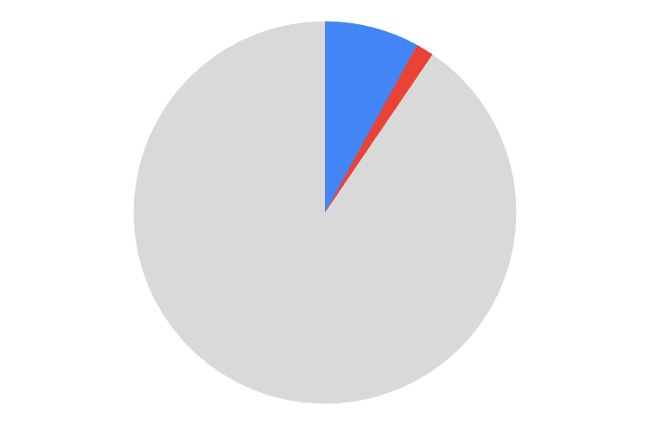
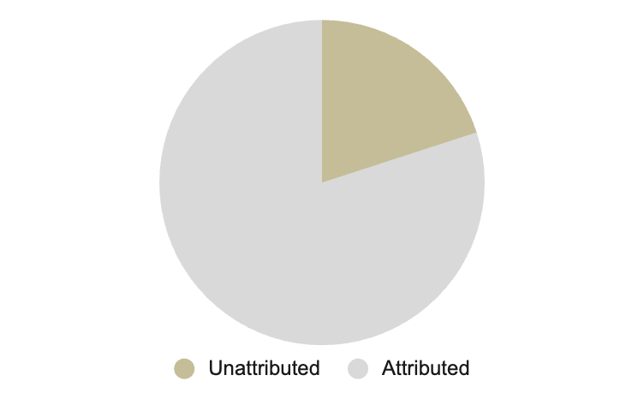
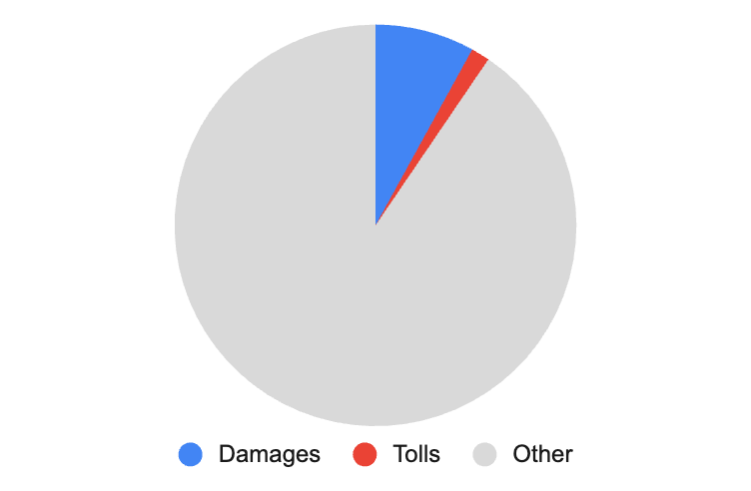
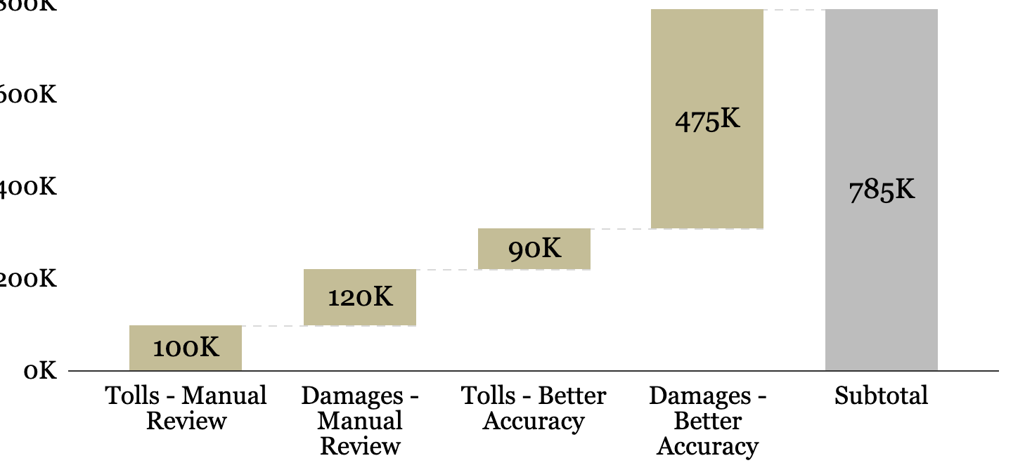
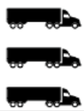
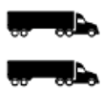



Using Predictive Analytics in Logistics Industry to Associate Tolls and Damages to Customers
Ananth Mohan, Farha Shireen, Hsueh-Ning Chao, Shih Min Lin, Tanvir Ahmed Farook, Yao Liu, Yijun Wang Under the guidance of Dr. Shoaib Khan
Purdue University, Daniels School of Business
ABSTRACT
Our approach enhances transparency with an interpretable model, reduces disputes, and streamlines operations for subscription-based trailer access model providers and customers.
METHODOLOGY
EXPECTED IMPACT
A predictive system integrating telematics and images from trailer activities is developed in this study to enhance cost attribution, as well as toll and damage tracking in the logistics business model. The goal is to automate trailer toll data attribution and improve damage detection by leveraging telematics data and applying image classification with deep learning. The results will contribute to the automation of damage identification and severity assessment, the aggregation of tolls with the corresponding trip, and the proper attribution to the correct parties in the freight chain.
TOLL
Tolls, damages and maintenance together contribute to about 10% of the total costs of a trip in the logistics industry. The hours spent on manually reviewing the reports and matching the drivers can be saved. The solution can increase the accuracy of attribution to drivers.
We arrived at this estimate based on the following assumptions: there are ~1000 trailers in operation, each trailer completes an average of four trips per week, it takes two minutes to review a report, the cost of labor is $15 per hour, and each trip incurs one toll charge.
Toll Agency sends Toll Data Report to Provider for Reimbursement
Automation Logic
Matching Subscriber to Tolls using Vehicle Identification Number
Update Database with matched data daily using batch
Trailer Subscription Information
Fig 3. Toll Study Design
Send out emails to customers with Toll amounts
DAMAGE
Fig 2. Using Trailer telematics Data and Machine Learning for right attribution to win customer trust
Read Report
If there is damage?
No
Exit
​Fig 5. 20% of the damages, maintenance and tolls remain unattributed, leading to host company eating the cost
INTRODUCTION
RESEARCH OBJECTIVES
Yes
Retrieve previous inspection report without the detected damage
Traditional 3PL logistics business models face challenges in balancing capacity and efficiency. Directly owning trailer assets requires a huge initial investment and ongoing maintenance costs, making capacity highly inflexible and leading to potential losses due to asset downtime. A subscription-based trailer access model offers a flexible solution to this challenge. Companies subscribe to trailer capacity, while the provider handles maintenance. This approach addresses the pain points of inflexible, seasonal capacity and high capital investment, expanding opportunities not only for 3PLs but also for brokers and carriers.
Under this trailer leasing model, the logistics industry faces challenges in cost attribution and damage tracking due to unknown parties in the freight chain, leading to inefficiencies and billing disputes. This study develops an analytics solution leveraging AI and telematics data to improve cost attribution and automate damage detection with limited data from logistics customers.
To identify predictive modeling approaches and data analytics systems that can improve the accuracy and efficiency of toll attribution in a subscription-based trailer access model.
To establish methods that enhance trailer damage monitoring together with attribution processes despite existing inspection irregularities and trailer exchange frequency.
Automatic Attribution
Damage Analysis
If previous report exist?
If damage report has images?
LITERATURE REVIEW
Yes
No
No
Yes
Cost allocation in logistics remains a challenge due to data inconsistencies and operational complexities. Prior research, such as Sheng Xu et al. (2020), introduced a Time-Driven-Activity-Based (TDABC) model integrated with shared logistics platforms to enhance real-time cost attribution. In parallel, damage detection research has explored the effectiveness of MobileNetV2 for classifying damage types in large-scale inspections (Wang et al., 2021; Cimili et al., 2022). These studies emphasize the strength of transfer learning but highlight gaps in quantifying damage severity for intelligent decision-making. Our work builds upon these foundations by integrating geospatial toll attribution with damage classification and severity labeling, ensuring accurate cost allocation and responsibility tracking in a subscription-based trailer access model.
Find all trips in between the two reports using telematics data
Look for previous 'n' customers who subscribed to the particular trailer
Exit
Image Processing
Only one customer picked trailer?
Any customers found?
Image Analysis
(MobileNetV2)
Yes
No
Yes
No
Assign Responsibility to customer
List suspicious customers
No data available
Manual review required
Report
Fig 6. The timely and accurate attribution can result in Annual savings close to USD 0.8 Million
Start_Location | Start_time | End_Location | End_time | Customer
Yard/Location A | FEB 1 1:00PM | Yard/Location B | FEB 1 3:00PM | Customer A
Yard/Location B | FEB 7 2:00PM | Yard/Location C | FEB 10 3:00PM | Customer A
Yard/Location C | FEB 21 3:00PM | Yard/Location D | FEB 22 8:00AM | Customer B
Damage Part | Damge Type | Severity
Left | Tires | Low
Rear | Wheels | High
CONCLUSION
Before automation, toll and damage attribution, as well as image comparison, were performed manually, leading to longer processing times and a higher risk of human error. By implementing an automated process, we were able to significantly reduce processing time by ~2-3 FTEs and cut costs by close 0.5 Million USD annually. Additionally, automation minimized manual errors, enhancing the accuracy and reliability of the attribution process.
Considering the industry's payment cycle, timely and accurate attribution is critical. The automation of toll and damage identification ensures faster invoicing of carriers and accelerates insurance claims and settlement processes. Ultimately, this enhances cash flow management, improves operational efficiency, and strengthens compliance with industry standards.
Study | Paper Aspect
 | Tolls |  | Damage
 | TDABC model | Shared Logistics Platform | MobileNetV2 | Semi-Supervised Learning | MultipleType damage classification | Model Enhancement
(Sheng Xu et al., 2020) | ✔ | ✔
(Pavel Cimili, et al., 2022) |  |  | ✔ | ✔
(Jiahao Chen et al., n.d.) |  |  |  |  | ✔ | ✔
(Zixin Wang et al., 2021) |  |  | ✔ |  | ✔
Our Study | ✔ |  | ✔ | ✔
Fig 4. Damage Study Design
Brokered Loads
Loads Assigned
LIMITATIONS & ASSUMPTIONS
Independent
Contractors
Data Integrity: Assumes accuracy and completeness of all input data, including toll reports, subscription information, inspection reports, and telematics data.
System Functionality: Assumes proper functioning of automated logic and database systems.
Data Latency: Delays in data acquisition (toll data, telematics) can impact the timeliness and accuracy of results.
Manual Intervention: Some cases require manual review, limiting full automation.
Scope Limitations: Methodologies address specific aspects (toll assignment, damage assessment) but may not cover all related processes (e.g., dispute resolution, fraud detection).
Brokered Loads
Mid-Sized Carriers
Loads Assigned
Large Carriers
Small Carriers
Company Drivers
Fig 1. Complexity of Freight Logistics
ACKNOWLEDGEMENT
Table 1. Literature Summary
We would like to thank Dr. Khan and our industry partner for this opportunity, their guidance, and support on this project.

Slide 2
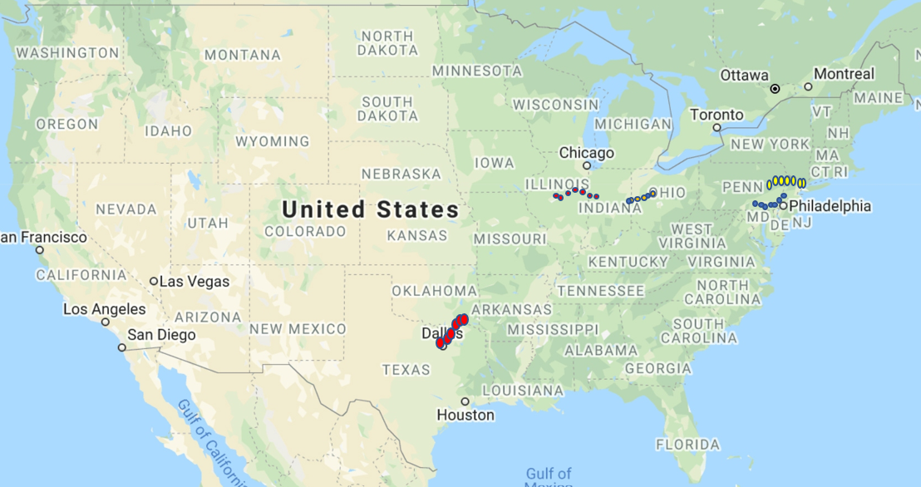
Using Predictive Analytics in Logistics Industry to Associate Tolls and Damages to Customers
Ananth Mohan, Farha Shireen, Hsueh-Ning Chao, Shih Min Lin, Tanvir Ahmed Farook, Yao Liu, Yijun Wang Under the guidance of Dr. Shoaib Khan
Purdue University, Daniels School of Business
ABSTRACT
RESEARCH OBJECTIVES
METHODOLOGY
EXPECTED IMPACT
A predictive system integrating telematics and images from trailer activities is developed in this study to enhance cost attribution, as well as toll and damage tracking in the logistics business model. The goal is to automate trailer toll data attribution and improve damage detection by leveraging telematics data and applying image classification with deep learning. The results will contribute to the automation of damage identification and severity assessment, the aggregation of tolls with the corresponding trip, and the proper attribution to the correct parties in the freight chain.
To identify predictive modeling approaches and data analytics systems that can improve the accuracy and efficiency of toll attribution in a subscription-based trailer access model.
To establish methods that enhance trailer damage monitoring together with attribution processes despite existing inspection irregularities and trailer exchange frequency.
TOLL
Tolls, damages and maintenance together contribute to about 10% of the total costs of a trip. The hours spent on manually reviewing the reports and matching the drivers can be saved. The solution can increase the accuracy of attribution to drivers.
We arrived at this estimate based on the following assumptions: there are ~1000 trailers in operation, each trailer completes an average of four trips per week, it takes two minutes to review a report, the cost of labor is $15 per hour, and each trip incurs one toll charge.
Toll Agency sends Toll Data Report to Provider for Reimbursement
Automation Logic
Matching Subscriber to Tolls using Vehicle Identification Number
Update Database with matched data daily using batch
Trailer Subscription Information
Send out emails to customers with Toll amounts
​Fig 6. 20% of the damages, maintenance and tolls remain unattributed, leading to host company eating the cost
INTRODUCTION
DAMAGE
Fig 4. Toll Study Design
Traditional 3PL logistics business models face challenges in balancing capacity and efficiency. Directly owning trailer assets requires a huge initial investment and ongoing maintenance costs, making capacity highly inflexible and leading to potential losses due to asset downtime. A subscription-based trailer access model offers a flexible solution to this challenge. Companies subscribe to trailer capacity, while the provider handles maintenance. This approach addresses the pain points of inflexible, seasonal capacity and high capital investment, expanding opportunities not only for 3PLs but also for brokers and carriers.
Under this trailer leasing model, the logistics industry faces challenges in cost attribution and damage tracking due to unknown parties in the freight chain, leading to inefficiencies and billing disputes. This study develops an analytics solution leveraging AI and telematics data to improve cost attribution and automate damage detection with limited data from logistics customers.
No
Read Report
If there is damage?
Exit
Yes
Retrieve previous inspection report without the detected damage
Automatic Attribution
Damage Analysis
If previous report exist?
If damage report has images?
Fig 3. Linking trip information by mapping telematics data
Yes
No
No
Yes
LITERATURE REVIEW
Find all trips in between the two reports using telematics data
Look for previous 'n' customers who subscribed to the particular trailer
Exit
Image Processing
Loads Assigned
Cost allocation in logistics remains a challenge due to data inconsistencies and operational complexities. Prior research, such as Sheng Xu et al. (2020), introduced a Time-Driven-Activity-Based (TDABC) model integrated with shared logistics platforms to enhance real-time cost attribution. In parallel, damage detection research has explored the effectiveness of MobileNetV2 for classifying multiple damage types in large-scale inspections (Wang et al., 2021; Cimili et al., 2022). These studies emphasize the strength of transfer learning but highlight gaps in quantifying damage severity for intelligent decision-making. Our work builds upon these foundations by integrating geospatial toll attribution with damage classification and severity labeling, ensuring accurate cost allocation and responsibility tracking in a subscription-based trailer access model.
Brokered Loads
Independent
Contractors
Only one customer picked trailer?
Any customers found?
Image Analysis
(MobileNetV2)
Fig 7. The timely and accurate attribution can result in Annual savings close to USD 0.8 Million
Brokered Loads
Mid-Sized Carriers
Loads Assigned
Yes
No
Yes
No
By implementing automated cost attribution, the company stands to gain substantial financial and operational benefits. The solution not only enhances transparency but also drives cost efficiency, ultimately leading to better resource management and increased profitability.
Large Carriers
Assign Responsibility to customer
List suspicious customers
No data available
Manual review required
Report
Small Carriers
Company Drivers
Start_Location | Start_time | End_Location | End_time | Customer
Yard/Location A | FEB 1 1:00PM | Yard/Location B | FEB 1 3:00PM | Customer A
Yard/Location B | FEB 7 2:00PM | Yard/Location C | FEB 10 3:00PM | Customer A
Yard/Location C | FEB 21 3:00PM | Yard/Location D | FEB 22 8:00AM | Customer B
Damage Part | Damge Type | Severity
Left | Tires | Low
Rear | Wheels | High
CONCLUSIONS
Fig 1. Complexity of Freight Logistics
Study | Paper Aspect
 | Tolls |  | Damage
 | TDABC model | Shared Logistics Platform | MobileNetV2 | Semi-Supervised Learning | MultipleType damage classification | Model Enhancement
(Sheng Xu et al., 2020) | ✔ | ✔
(Pavel Cimili, et al., 2022) |  |  | ✔ | ✔
(Jiahao Chen et al., n.d.) |  |  |  |  | ✔ | ✔
(Zixin Wang et al., 2021) |  |  | ✔ |  | ✔
Our Study | ✔ |  | ✔ | ✔
Before automation, toll and damage attribution, as well as image comparison, were performed manually, leading to longer processing times and a higher risk of human error. By implementing an automated process, we were able to significantly reduce processing time by ~2-3 FTEs and cut costs by close 0.5 Million USD annually. Additionally, automation minimized manual errors, enhancing the accuracy and reliability of the attribution process.
Our approach enhances transparency with an interpretable model, reduces disputes, and streamlines operations for subscription-based trailer access model providers and customers.
Fig 5. Damage Study Design
ASSUMPTIONS
Data Integrity: Assumes accuracy and completeness of all input data, including toll reports, subscription information, inspection reports, and telematics data.
System Functionality: Assumes proper functioning of automated logic and database systems.
Considering the industry's payment cycle, timely and accurate attribution is critical. The automation of toll and damage identification ensures faster invoicing of carriers and accelerates insurance claims and settlement processes. Ultimately, this enhances cash flow management, improves operational efficiency, and strengthens compliance with industry standards.
LIMITATIONS
Data Latency: Delays in data acquisition (toll data, telematics) can impact the timeliness and accuracy of results.
Manual Intervention: Some cases require manual review, limiting full automation.
Scope Limitations: Methodologies address specific aspects (toll assignment, damage assessment) but may not cover all related processes (e.g., dispute resolution, fraud detection).
ACKNOWLEDGEMENTS
Fig 2. Using Trailer telematics Data and Machine Learning for right attribution to win customer trust
We would like to thank Dr. Khan and our industry partner for this opportunity, their guidance, and support on this project.
Table 1. Literature Summary

